Slide 2
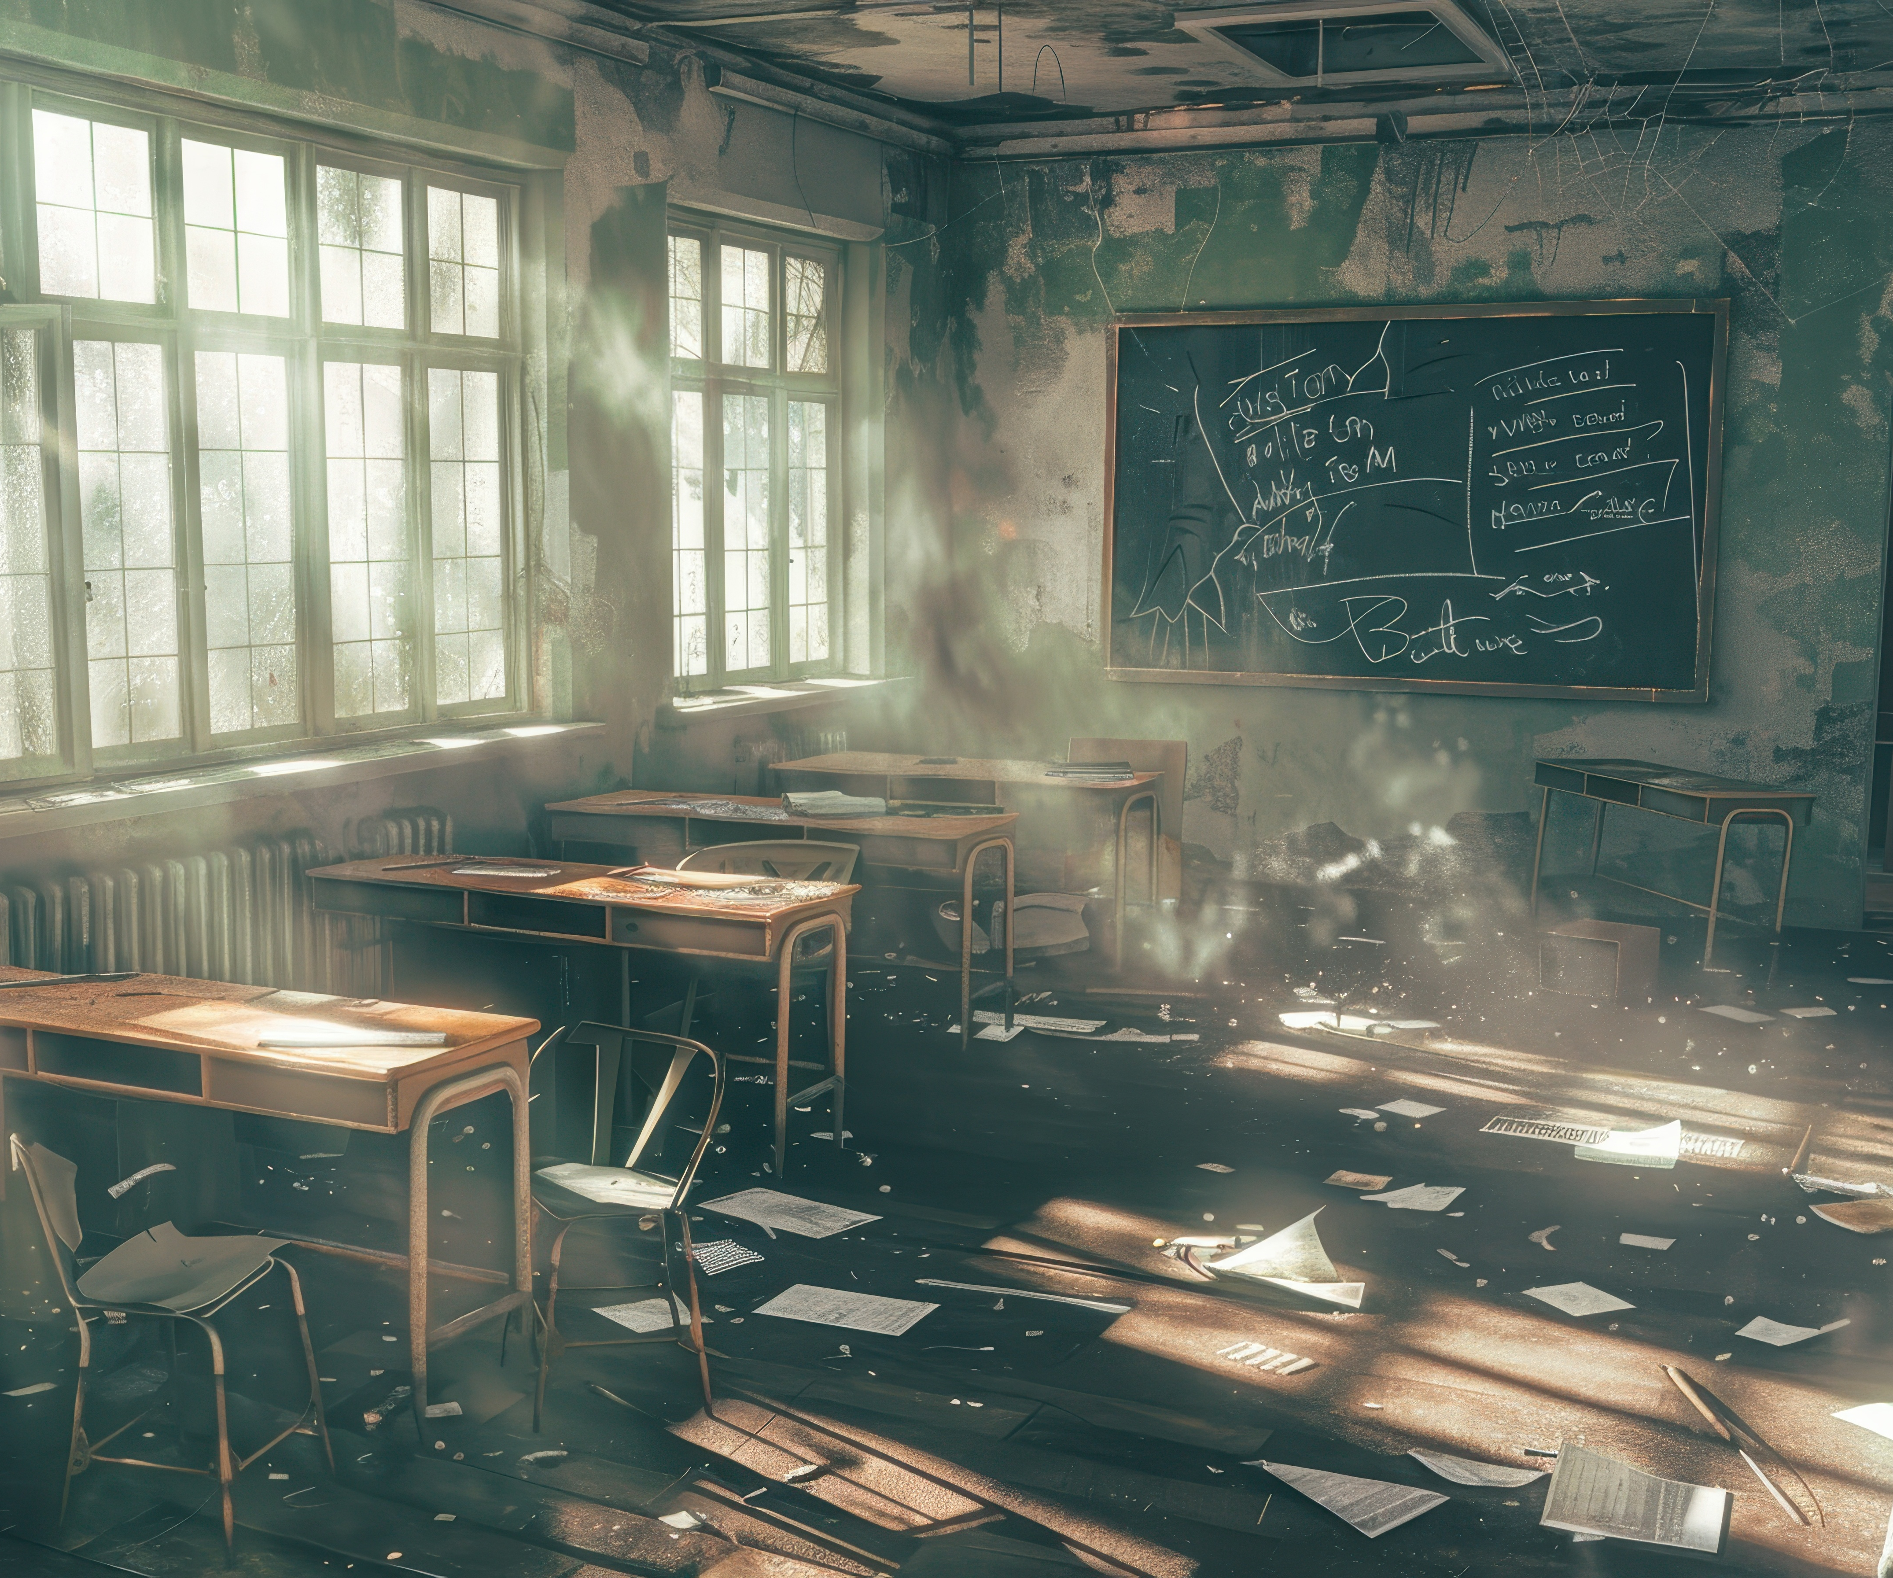

Clean the classroom.

Slide 3
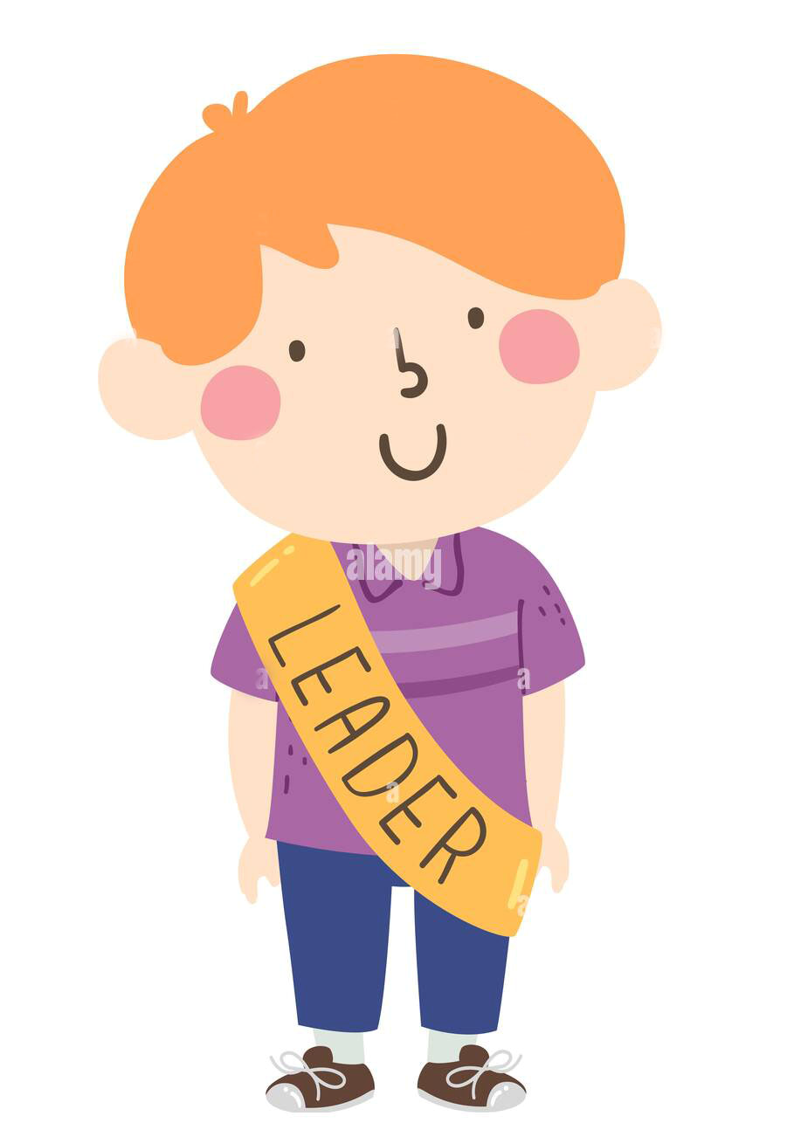
Ok. Clean what?

Slide 4
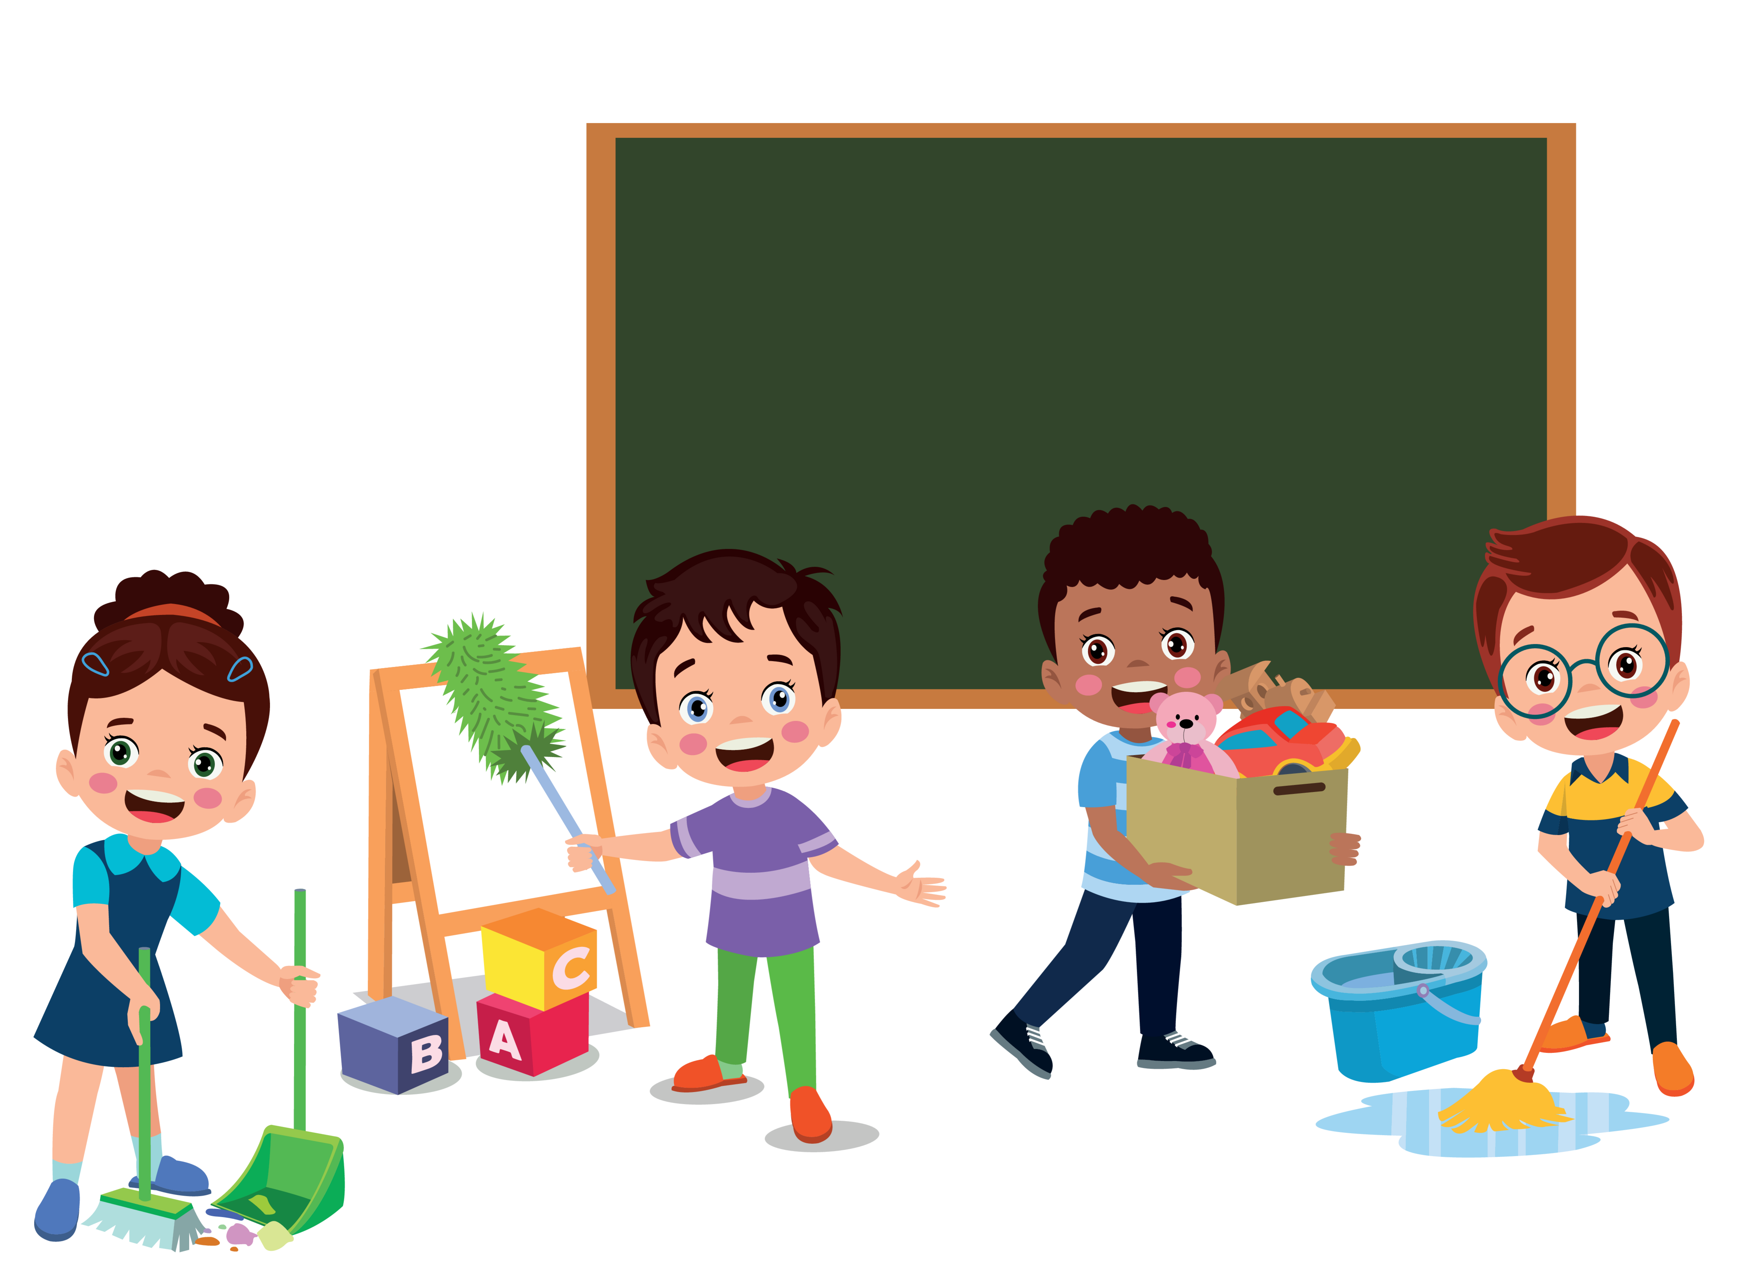
Ok. But what do we clean?

Slide 5
There are many
things to clean.

Slide 6
…and many things to do.

Slide 7
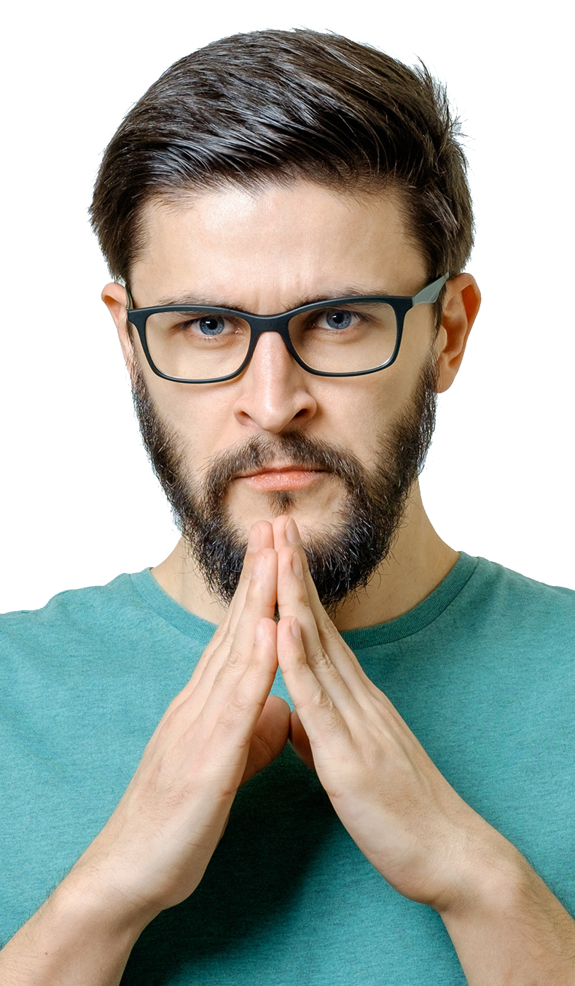
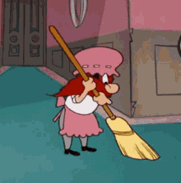

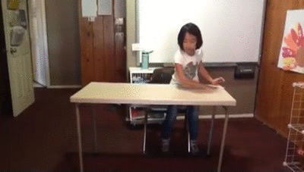
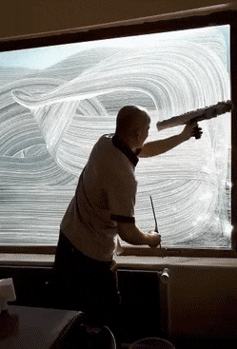
1. Sweep (the floor).
2. Mop (the floor).
3. clean the desks
4. clean the windows

Slide 8
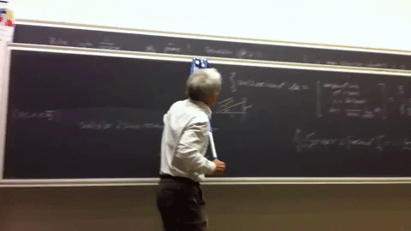
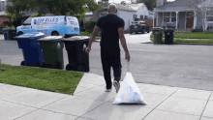
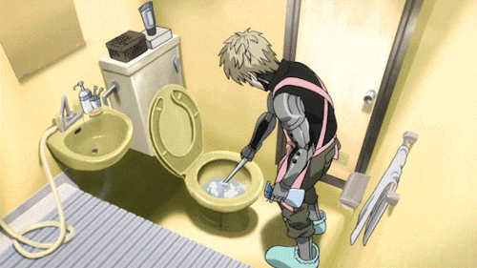
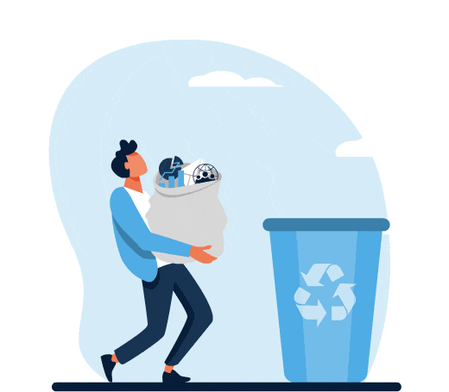
5. Clean the blackboard.
6. Take out the trash.
7. Clean toilets.
8. Take out the recycling.

Slide 9
Who

Slide 10
w
i
ll
（表示單純的將來）將；
（表示意志，意願）願，要

Slide 11
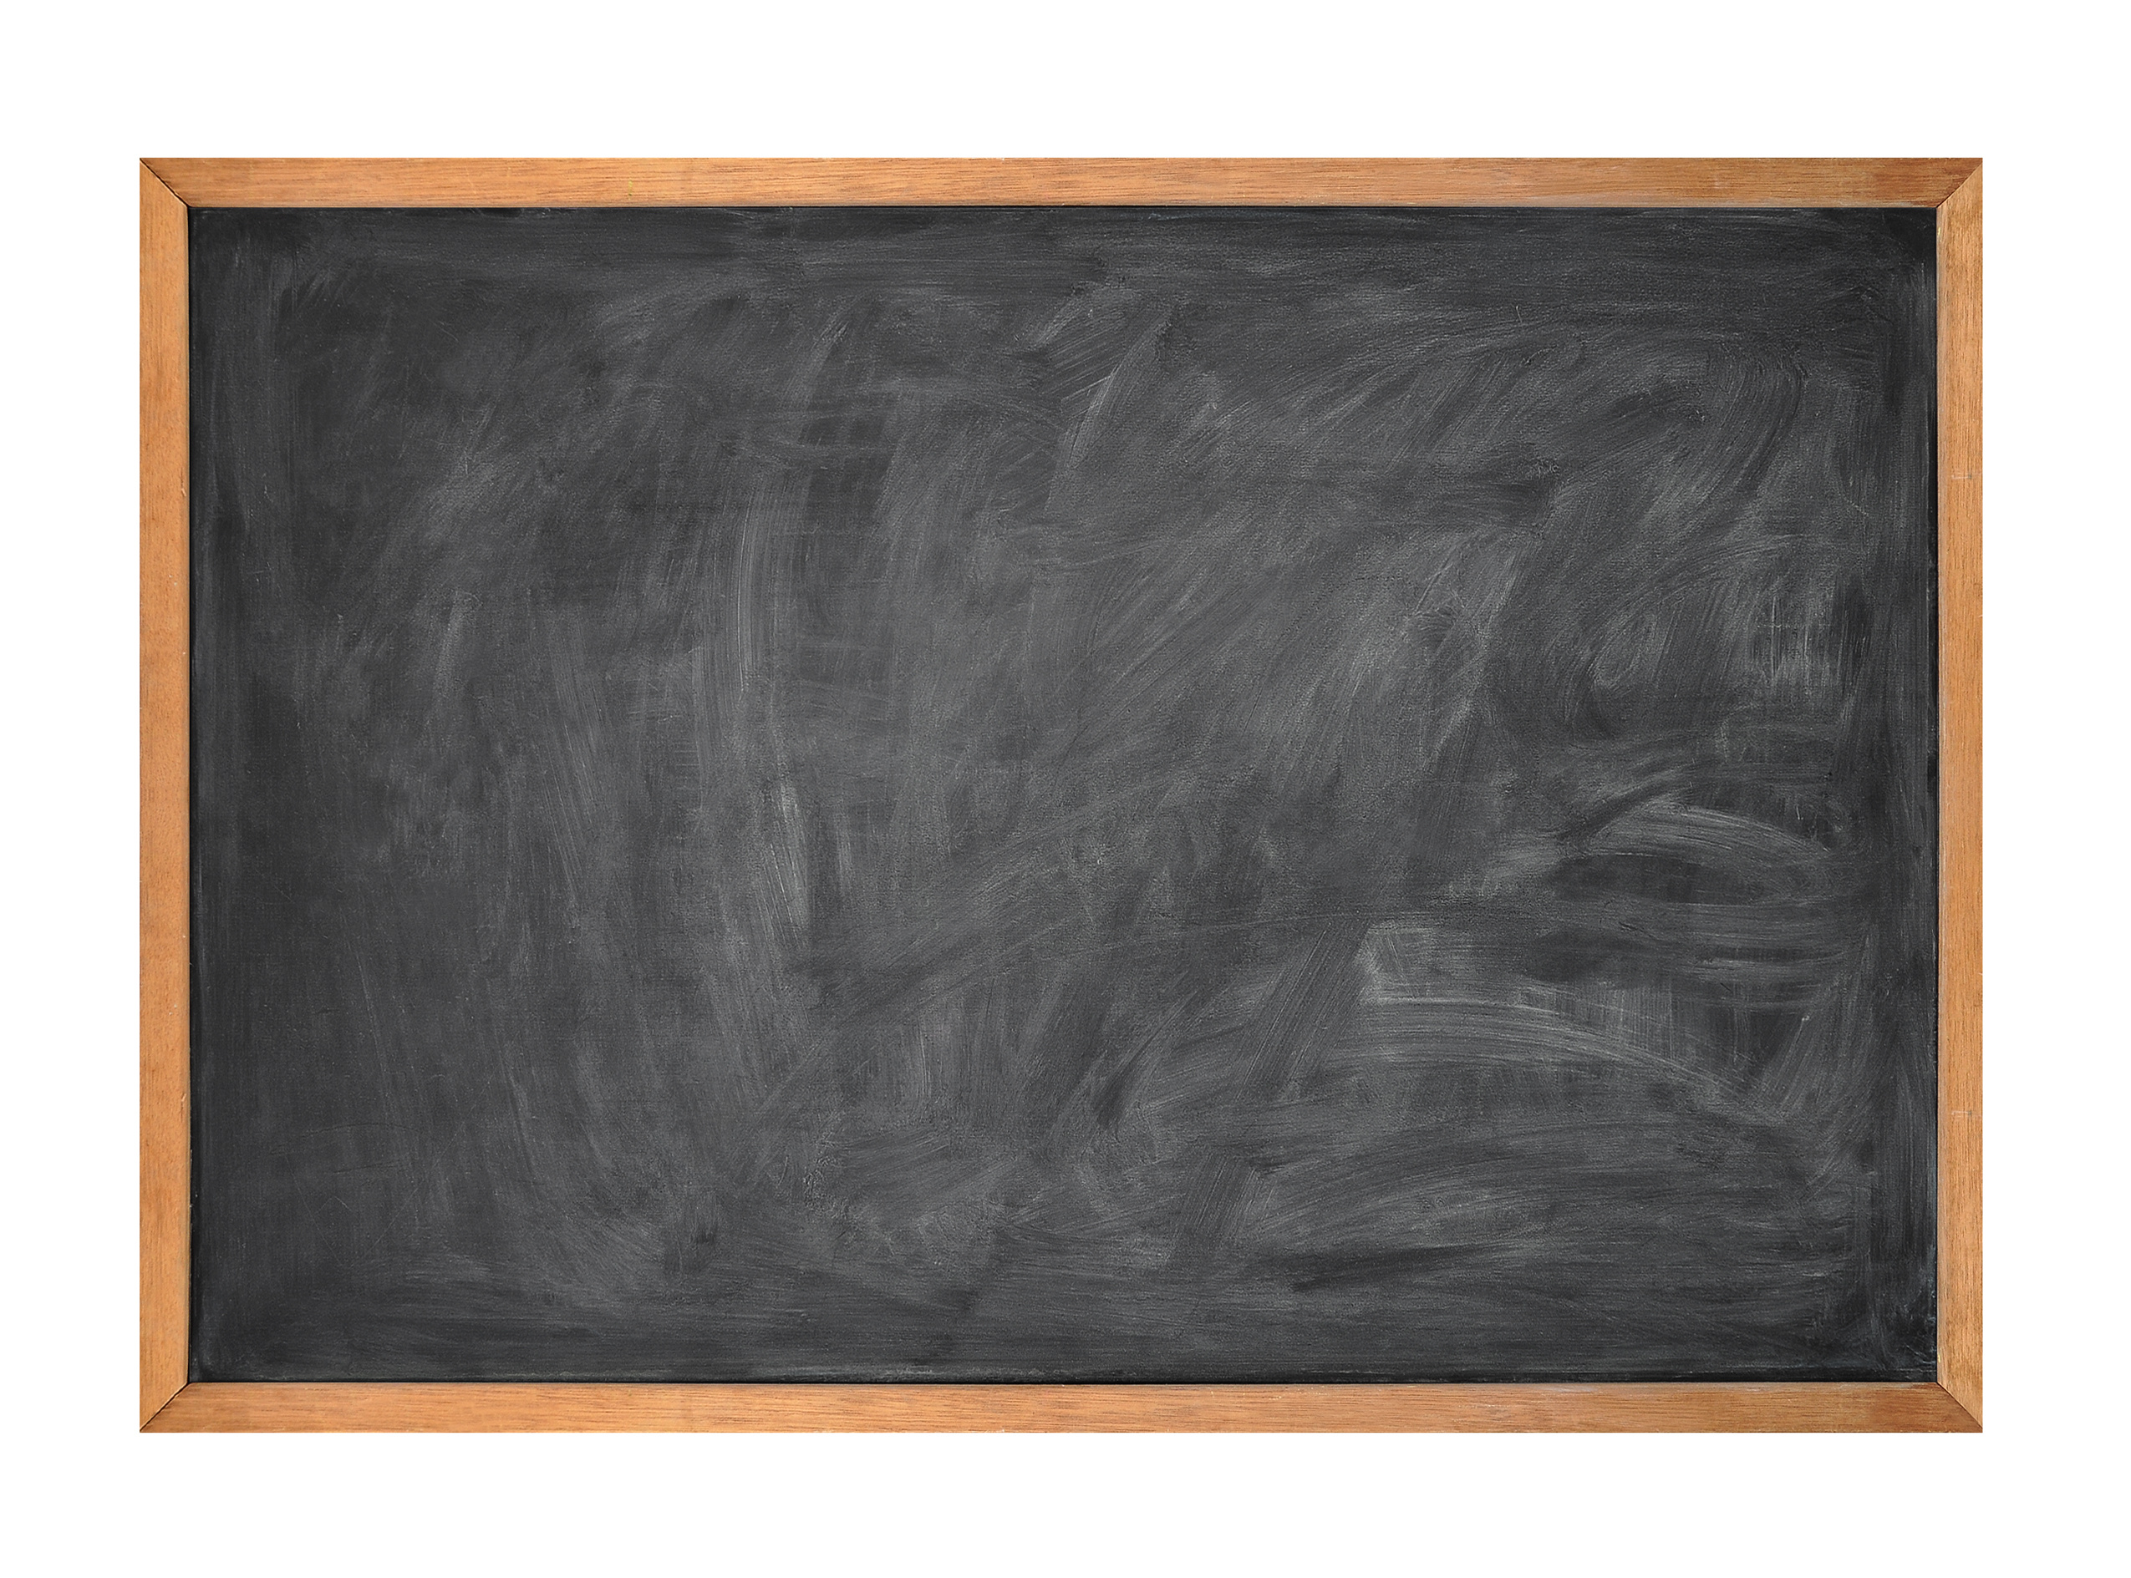
Who will clean the blackboard?

Slide 12
ch
oo
se
選擇；挑選；（投票）選舉

Slide 13
You choose.

Slide 14
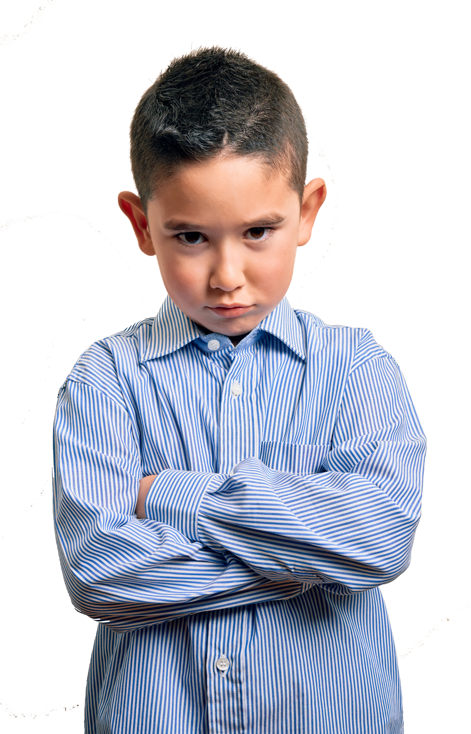
You clean the blackboard?

Slide 15
But I don’t want to!

Slide 16
Clean the blackboard!

Slide 17
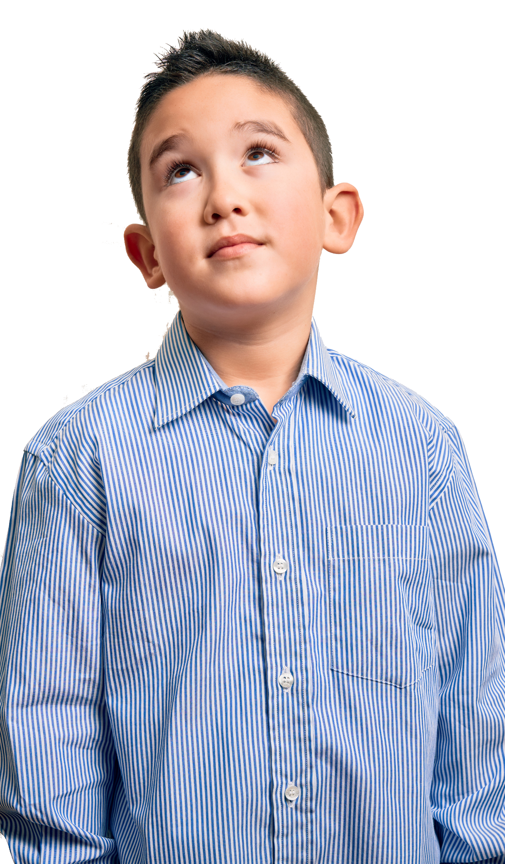
Please.
Hmm…

Slide 18

Ok.

Slide 19

Good job!

Slide 20
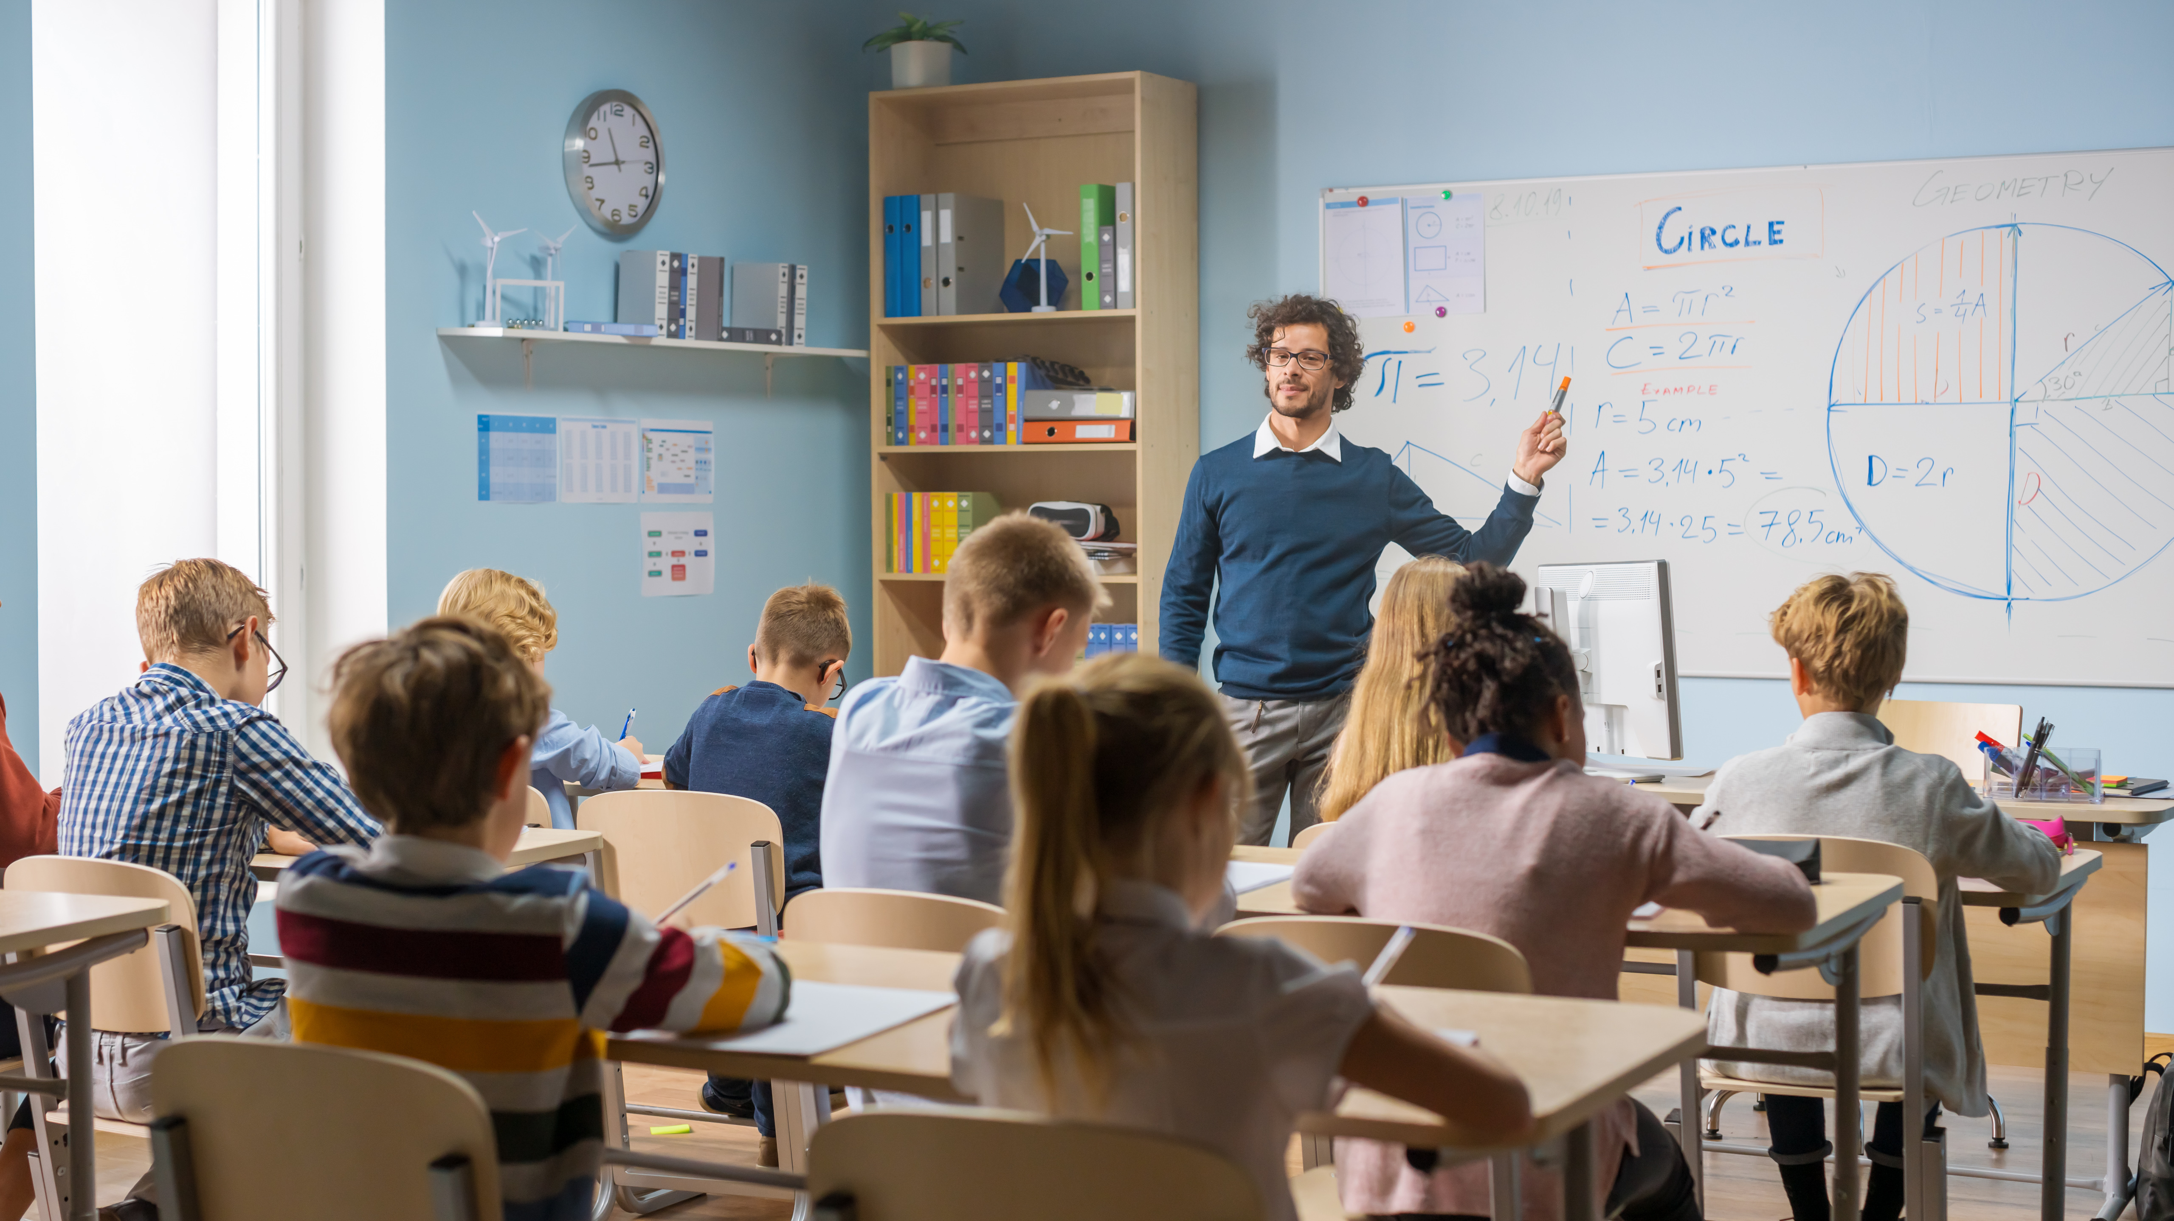
No homework, please!
Please, don’t give homework!

Slide 21
a
ss
ig
n
佈置

Slide 22
No homework, please!
Please, don’t assign homework!
Please, don’t give homework!

Slide 23
There …
有，擁有
… there.
在那裡；到那裡；向那裡
（表示滿意，得意，鼓勵，安慰，挑釁等）你瞧；好啦；喂
There, there. Stop crying. 好啦，好啦，別哭了。

Slide 24
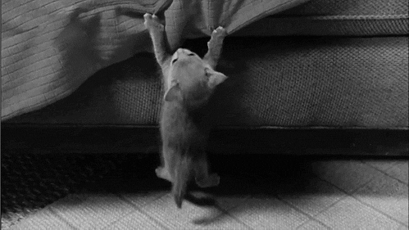
Hang in there.
堅持住。
頂住！
不要放棄。

Slide 25
